Slide 1
SCS1201 – Advanced Data Structures
B.E. CSE – II Year / III Semester

Slide 2
UNIT II – Advanced Tree Concepts
Threaded Binary Trees
AVL Tree
B-Tree
Insertion
Deletion
Splay Trees
Heap Trees
Heapify Procedure
Tries

Slide 3
Threaded Binary Tree
In the Binary Tree representation using Linked List, it is observed that there are more null pointers (0-links) rather than the actual pointers.
n+1 null pointers (n – total number of nodes)
2n total number of links
Replace null pointers by pointers called threads to other nodes in the tree. (A J Perlis and C Thornton)

Slide 4
Example
A
B
C

Slide 5
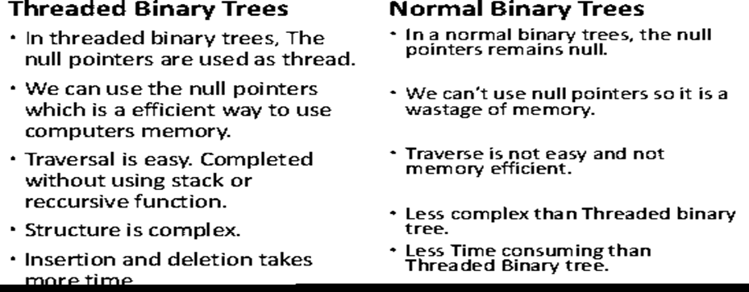
Difference between threaded and normal binary tree

Slide 6
Why do you go for threaded binary trees?
Binary trees have a lot of wasted space.
The idea of threaded binary trees is to make inorder traversal faster and do it without stack and without recursion.
Reduces the time complexity of the algorithm.

Slide 7
Rule 1 – Threaded Binary Tree
A 0 rightChild field in node p is replaced by a pointer to the node that would be visited after p when traversing the tree in inorder.
i.e. it is replaced by the inorder successor of p.

Slide 8
Rule 2 – Threaded Binary Tree
A 0 leftChild field at node p is replaced by a pointer to the node that immediately precedes node p in inorder.
i.e. it is replaced by the inorder predecessor of p.

Slide 9
Example
A
B
C
D
E
F
G
H
I
H, D, I, B, E, A, F, C, G

Slide 10
Threaded Binary Tree
The threads H and G have been left dangling.
To avoid the loose threads, a header node is created for all threaded binary trees
The original tree is the left subtree of the header node.
leftThread | leftChild | data | rightChild | rightThread
true |  |  |  | false

Slide 11
Memory representation of Threaded Binary Tree
f |  | - |  | f
f |  | A |  | f
f |  | B |  | f
f |  | C |  | f
f |  | D |  | f
t |  | E |  | t
t |  | F |  | t
t |  | G |  | t
t |  | H |  | t
t |  | I |  | t

Slide 12
Questions for you:
Threaded binary tree concept was introduced by------
Traversal is easy in Threaded BT. True or False-----------
Insertion of data takes less time in Threaded BT. Say True or False---------
A null left child field in node p is replaced by the ----------------- of p.
Information needed to represent the linked list representation of a threaded binary tree.

Slide 13
Questions for you:
Normal binary tree is less complex than a threaded binary tree. True or False
A 0 right child field at node p is replaced by the ---------------------------- of p.
We use stack concept to do inorder traversal in a Threaded BT.(True/False)
Recursion technique is not used for inorder traversal in TBT.(True/False)
In TBT, -------------- pointers are used as threads.

Slide 14
Insertion of Months in a year
Jan
A
B
C
D
E
F
G
H
I
J
K
L
M
N
O
P
Q
R
S
T
U
V
W
X
Y
Z
Mar
Feb
May
Jun
Apr
Sep
Jul
Aug
Oct
Dec
Nov

Slide 15
Balanced Tree
JUL
JUL
FEB
FEB
MAY
MAY
AUG
AUG
MAR
JAN
MAR
JAN
OCT
OCT
SEP
APR
SEP
APR
NOV
DEC
NOV
DEC
JUN
JUN

Slide 16
AVL Trees (Adelson, Velskii, Landis)
An empty tree is height-balanced.
If T is a non empty binary search tree with T_{L} and T_{R} as its left and right subtrees respectively, then T is height balanced if and only if
T_{L} and T_{R} are height balanced
| h_{L} - h_{R} | ={-1,0,1} where h_{L} and h_{R} are the heights of T_{L} and T_{R} respectively.
i.e. For any node in an AVL Tree the Balance Factor(T) should be either -1 or 0 or 1

Slide 17
Example
Jan
-2
-2
Mar
Feb
-2
May
-3
Jun
APR
1
Sep
-1
2
Aug
Jul
Oct
0
0
1
Nov
0

Slide 18
Example
JUL
0
1
0
FEB
MAY
0
0
AUG
0
JAN
1
MAR
OCT
0
0
0
0
APR
DEC
JUN
NOV
SEP
0

Slide 19
Rotations in Search Trees
Rotations
Single
Double
Left of Left Rotation (LL)
Right of Right Rotation (RR)
Left of Right Rotation (LR)
Right of Left Rotation (RL)

Slide 20
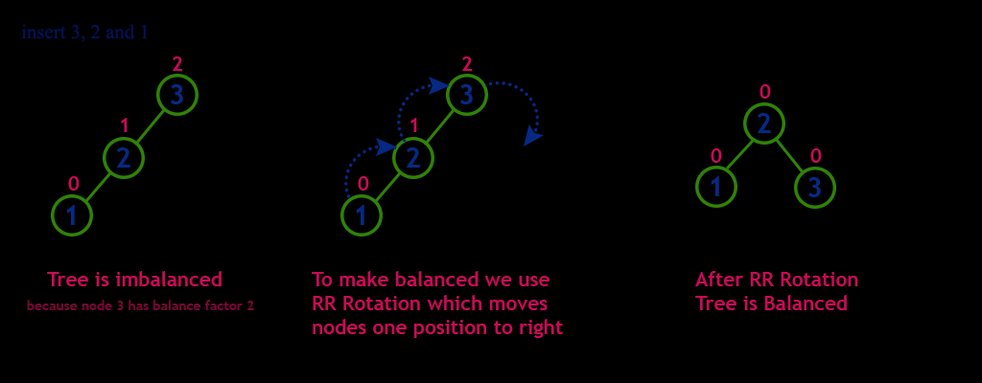
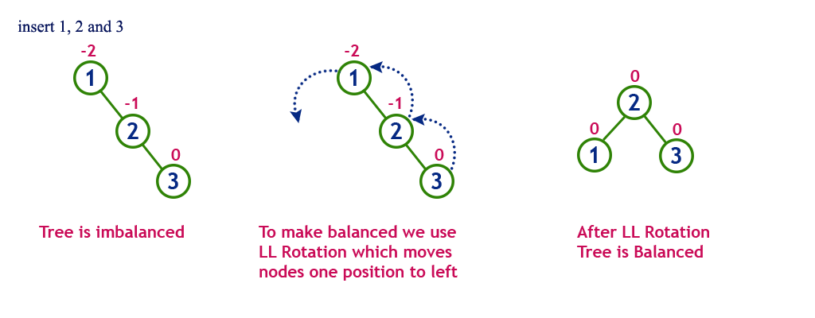
CASE LL (Left of Left Rotation)
Insert 3, 2, 1
Tree is imbalanced.
Key 3 – is imbalanced
Perform LL on Key 3
Tree is balanced

Slide 21
Algorithm- LEFT-OF-LEFT(pivot)
P = left(pivot)
Q = right(P)
Root = P
Right(P) = pivot
Left(pivot) = Q
Bal(pivot) = 0
Bal(left(pivot)) = 0

Slide 22
CASE LL (Left of Left Rotation)
Insert 3, 2, 1
Root = 2
Pivot 3 becomes right(2)
Left (3) = Null
Pivot = 3
P = 2
Q = Null
Perform LL on Key 3

Slide 23
CASE RR (Right of Right Rotation)
Insert 1, 2, 3
Tree is imbalanced.
Key 1 – is imbalanced
Perform RR on Key 1
Tree is balanced

Slide 24
Algorithm- Right of Right (pivot)
P = right(pivot)
Q = left(P)
Root = P
Left(P) = pivot
Right(pivot) = Q
Bal(pivot) = 0
Bal(right(pivot)) = 0

Slide 25
CASE RR (Right of Right Rotation)
Insert 1, 2, 3
Pivot = 1
P = 2
Q=left(2)=null
Perform RR on Key 1
Root = 2
Left (2) = 1
Right(1)= null

Slide 26
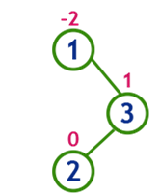
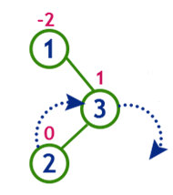
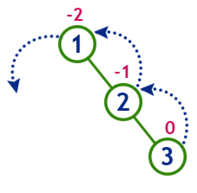
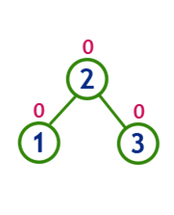
CASE LR (LR Rotation)
Insert 1, 3, 2
Tree is imbalanced
Key 1 – is imbalanced
Tree is balanced

Slide 27
Algorithm – Left of Right Rotation (LR)
P = right(pivot)
Q = left(P)
Root= Q
Right(Q) = P
Left(Q) = Pivot
Right(pivot) = left(Q)
Left(P) = right(Q)

Slide 28
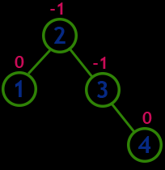
Insertion
Insert 4
Tree is balanced

Slide 29
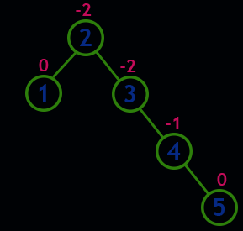
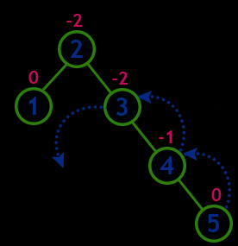
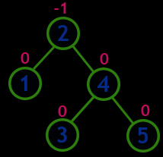
Insertion
Insert 5
Tree is imbalanced
RR Rotation on Key 3
Tree is balanced

Slide 30
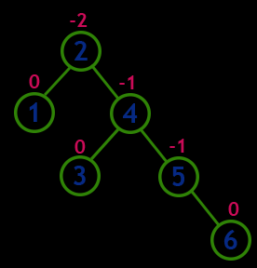
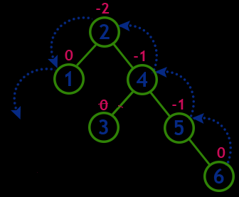
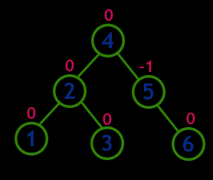
Insertion
Insert 6
Tree is imbalanced
RR Rotation on Key 2
Tree is balanced

Slide 31
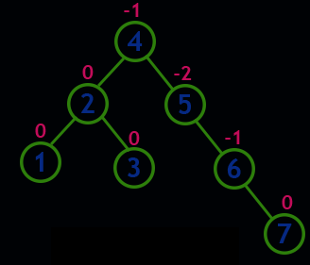
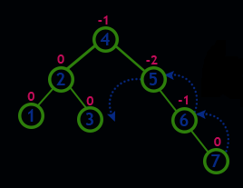
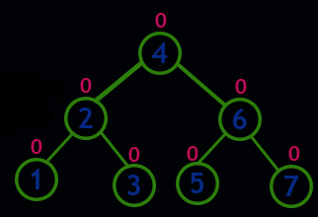
Insertion
Insert 7
Tree is imbalanced
RR Rotation on Key 5
Tree is balanced

Slide 32
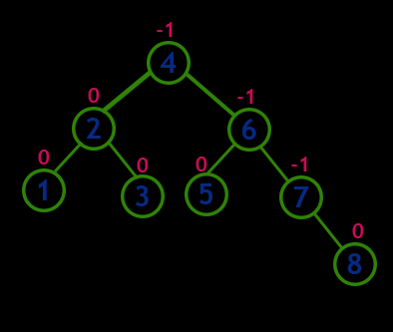
Insertion
Insert 8
Tree is balanced

Slide 33
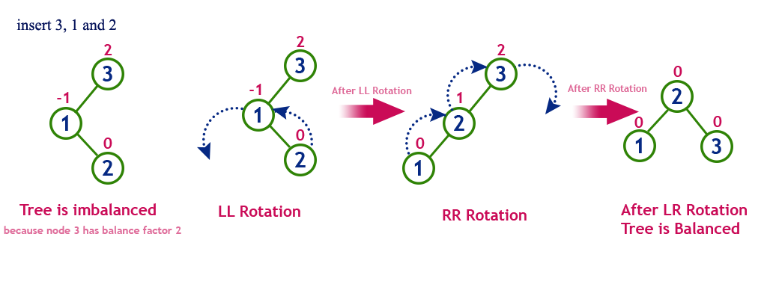
CASE RL (Right of Left Rotation)
Insert 3, 1, 2
Tree is imbalanced.
Key 3 – is imbalanced
Tree is balanced

Slide 34
Algorithm - Right of Left Rotation
P = left(pivot)
Q = right(P)
Root = Q
Left(Q) = P
Right(Q) = Pivot
Left(pivot) = right(Q)
Right(P) = left(Q)

Slide 35
Deletion in AVL Tree
The deletion operation is similar to deletion operation in Binary Search Trees.
After every deletion operation, it is necessary to check the Balance Factor Condition.
If the tree is balanced after deletion then
perform the next operation
else
compute the appropriate rotation to ensure that the tree is height balanced.

Slide 36
m-Way Search Trees (multiway search trees)
Generalised versions of binary trees.
Each node contains multiple elements.
In an m-way tree of order m, each node contains a maximum of m-1 elements and m children.

Slide 37
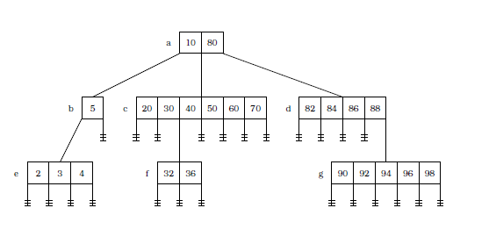
Example – m-way search tree

Slide 38
Conditions for a B-Tree
(i) All non-leaf nodes (except root node) have at least n/2 children and maximum n children.
(ii) The non-leaf root node may have at least 2 children and maximum n children.
(iii) B-Tree can exist with only one node. i.e. the root node containing no child.
(iv) If a node has n children then it must have n-1 values.

Slide 39
Conditions for a B-Tree
(v) All the values that appear on the left most child of a node are smaller than the first value of that node. All values that appears on the right most child of a node are greater that the last values of that node.
(vi) If x and y are any two ith and (i+1)th values of a node, where x < y, then all the values appearing on the (i+1)th sub-tree of that node are greater than x and less than y.
(vii) All the leaf nodes should appear on the same level. All the nodes except root node should have minimum n/2 values.

Slide 40
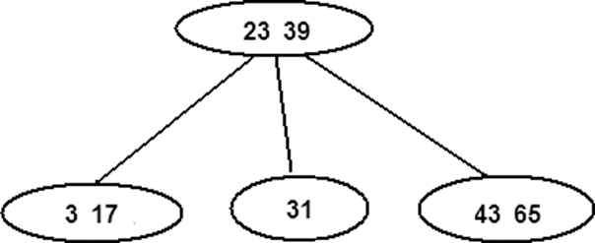
Example B Tree of order 3

Slide 41
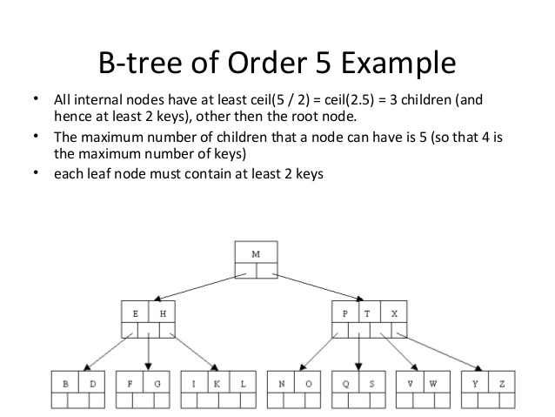

Slide 42
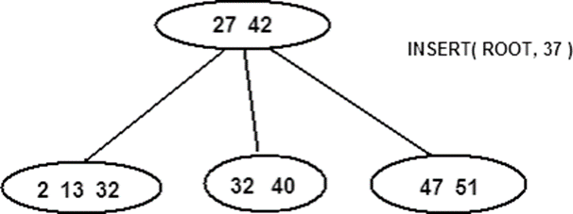
Insertion in a B Tree of order 4

Slide 43
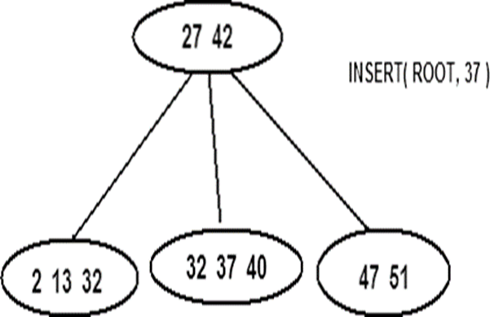
Insert key 37

Slide 44
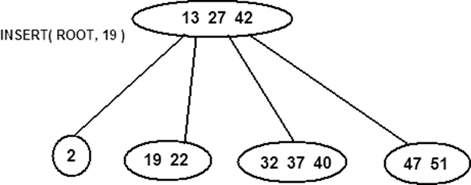
Insert key 19
A B tree of order 4 can have only maximum 3 values in it.
The node is split into two nodes.
The mid value 13 is pushed into the parent.

Slide 45
Example 2 - B-Tree of Order 3
30
80
20
50
60
90
10
25
35
40
55
70
82
85
95

Slide 46
Insert 44
The element is added to the internal node [35, 40].

Slide 47
30
80
20
50
60
90
10
25
35
40
44
55
70
82
85
95

Slide 48
Example 2 - B-Tree of Order 3
30
80
20
40
50
60
90
10
25
35
44
55
70
82
85
95

Slide 49
30
50
80
20
40
60
90
10
25
35
44
55
70
82
85
95

Slide 50
B Tree of Order 2
Insert 92, 96, 87, 88
50
30
80
20
40
60
90
10
25
35
44
55
70
82
85
95

Slide 51
Deletion
Case 1: The node from which the value is deleted has minimum n/2 values even after deletion.
Case 2: After deletion, the node has less than n/2 values.
Case 3: After deletion, if all the nodes have exactly the minimum number of nodes, no value can be borrowed from any of the adjacent nodes.

Slide 52
Case 1: Delete 50 (B Tree of order 7)
10 | 80
2 | 3 | 4 | 6
20 | 30 | 40 | 50 | 60 | 70
82 | 84 | 86 | 88
10 | 80
2 | 3 | 4 | 6
20 | 30 | 40 | 60 | 70
82 | 84 | 86 | 88

Slide 53
Case 2
When the element is being deleted from a non-root node that has exactly the minimum number of elements,
replace the deleted element with an element from its nearest left or right sibling.
Every node other than the root has either a nearest left or right sibling or both.

Slide 54
Case 2 : Delete 25 (B Tree of order 7)
10 | 40 | 80
2 | 3 | 4 | 6
20 | 25 | 30
50 | 60 | 70
82 | 84 | 86 | 88
The deletion leaves behind the node [20, 30], which has just two elements.
Since this is node is not a root node of B-Tree of Order 7, it must contain atleast three elements.
Its nearest sibling [2, 3, 4, 6] has an extra element.
The largest element from here is moved to the parent node, and the intervening element (10) is moved down.

Slide 55
After Deleting 25
6 | 40 | 80
2 | 3 | 4
10 | 20 | 30
50 | 60 | 70
82 | 84 | 86 | 88

Slide 56
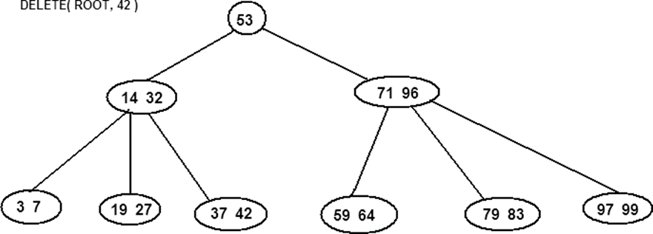
Case 3 : Delete 42 (B Tree of order 5)

Slide 57
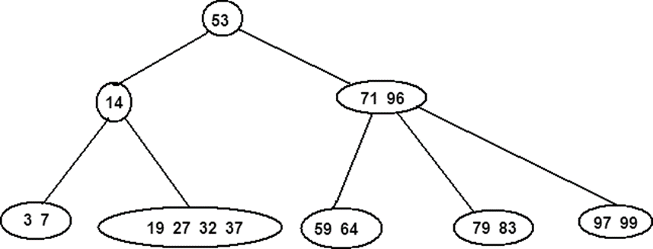

Slide 58
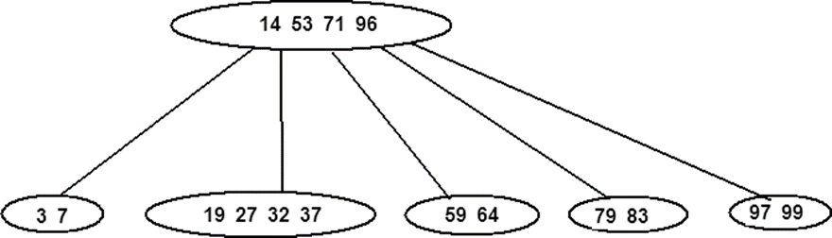

Slide 59
Splay Trees
A splay tree is a self-adjusting binary search tree
Recently accessed elements are quick to access again.
It performs basic operations such as insertion, look-up and removal in O(log n) time

Slide 60
Tree splaying
Rearranges the tree so that a certain element is placed at the root of the tree.
First perform a standard binary tree search for the element in question, and then use tree rotations in a specific fashion to bring the element to the top.

Slide 61
Advantages of splay tree
It is self-optimizing
Frequently accessed nodes will move nearer to the root where they can be accessed more quickly.

Slide 62
Splay Rotations (6 types)
• Left and right rotations
• Zig-zig left-left and zig-zig right-right rotations
• Zig-zag left-right and zig-zag right-left rotations

Slide 63
Node q has a parent p
p
q
Left Rotation
q
p
c
a
b
c
a
b
p – parent
q – splay node
a,b,c - Subtrees

Slide 64
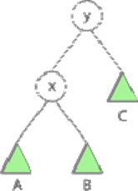
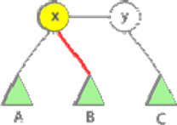
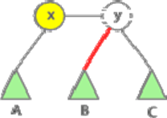
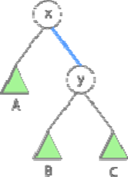
Right Rotation (Splay node is x)

Slide 65
If ‘q’ has a parent, ‘p’ and a grand parent ‘gp’ then the rotation is classified as:
(a) ZIG ZIG: LL ( p -> left child of gp, q -> left child of p)
(b) ZIG ZAG: LR ( p -> left child of gp, q -> right child of p)
(c) ZAG ZAG: RR ( p -> right child of gp, q -> right child of p)
(d) ZAG ZIG: RL ( p -> right child of gp, q -> left child of p)

Slide 66
LL, LR, RR and RL in a splay
gp
q
p
RR CASE
p
d
a
gp
q
c
b
a
b
c
d
gp – grand parent
p – parent
q – splay node
a,b,c - Subtrees

Slide 67
gp
q
gp
p
p
a
RL CASE
q
d
c
d
a
b
b
c
Assignment: LL and LR CASE

Slide 68
Initial Search Tree
1
1
9
9
a
a
j
8
j
8
i
2
i
2
b
7
RR Rotation
b
7
6
h
6
h
g
5
g
3
q
c
4
4
f
5
q
d
3
e
e
f
c
d

Slide 69
1
9
a
1
8
j
9
a
2
i
8
j
b
7
LL Rotation
2
i
6
h
b
5
q
5
g
q
4
6
4
f
7
3
e
f
3
e
c
d
g
h
c
d

Slide 70
1
1
9
a
9
a
8
j
5
j
q
2
i
LR Rotation
2
8
b
5
q
6
b
4
6
i
4
7
7
3
e
f
3
e
f
g
c
d
g
h
c
d
h

Slide 71
5
1
q
9
a
1
9
5
j
q
a
RL Rotation
2
j
2
8
8
6
4
b
4
i
b
6
i
7
3
e
3
e
f
7
f
c
d
c
d
g
h
g
h

Slide 72
Heap Trees
Heap is a special case of balanced binary tree data structure where the root-node key is compared with its children and arranged accordingly.
If α has child node β then −
key(α) ≥ key(β)
As the value of parent is greater than that of child, this property generates Max Heap.

Slide 73
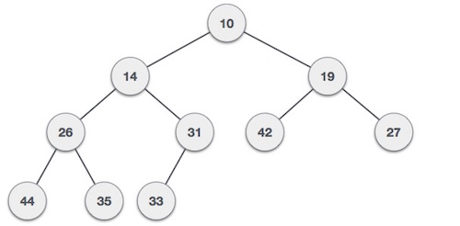
Minimum Heap

Slide 74
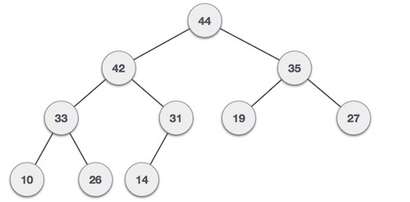
Maximum Heap

Slide 75
Max Heap Construction Algorithm
Step 1 − Create a new node at the end of heap.
Step 2 − Assign new value to the node.
Step 3 − Compare the value of this child node with its parent.
Step 4 − If value of parent is less than child, then swap them.
Step 5 − Repeat step 3 & 4 until Heap property holds.

Slide 76
Example
35, 33, 42, 10, 14, 19, 27, 44, 26, 31

Slide 77
Max Heap Deletion Algorithm
Step 1 − Remove root node.
Step 2 − Move the last element of last level to root.
Step 3 − Compare the value of this child node with its parent.
Step 4 − If value of parent is less than child, then swap them.
Step 5 − Repeat step 3 & 4 until Heap property holds.

Slide 78
Delete 44

Slide 79
Tries
Digital tree or radix tree or prefix tree.
Tries are an excellent data structure for strings.
Tries is a tree data structure used for storing collections of strings.
Tries came from the word retrieval.
Nodes store associative keys (strings) and values.

Slide 80
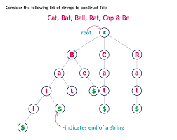
Example

Slide 81
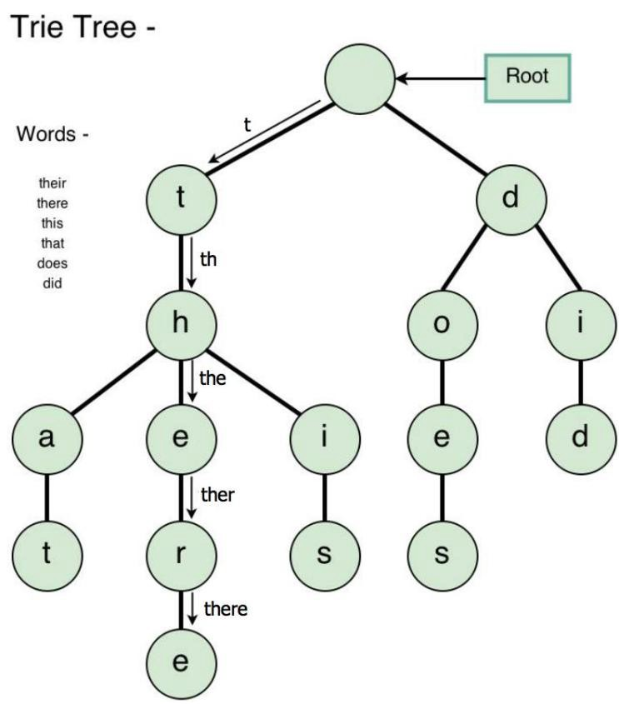
Example

Slide 82
Example of Binary trie
0
1
0
1
0
0
0
1
0
1
11
0
1
0
0
0
1
000
001
0
1
0
1
1000
1001

Slide 83
Digital Search Trees
Assume fixed number of bits.
Not empty =>
Root contains one dictionary pair (any pair).
All remaining pairs whose key begins with a 0 are in the left subtree.
All remaining pairs whose key begins with a 1 are in the right subtree.
Left and right subtrees are digital subtrees on remaining bits.

Slide 84
Example
Start with an empty digital search tree and insert a pair whose key is 0110.
0110
Now, insert a pair whose key is 0010.
0110
0010

Slide 85
Insert the key: 1001
0110
0110
0010
0010
1001

Slide 86
Insert the key: 1011
0110
0110
0010
0010
1001
1001
1011

Slide 87
Insert the key: 0000
0110
0110
0010
1001
0010
1001
1011
0000
1011

Slide 88
Search operation
Searching for a key begins at the root node, compare the characters and move down.
The search can terminate due to end of string or lack of key in tries.

Slide 89
Insertion
Find the place of the item by following bits.
If there is nothing, just insert the item there as a leaf node.
If there is something on the leaf node, it becomes a new internal node. Build a new sub tree to that inner node.
Create new leaf nodes where you store the item that was to be inserted.

Slide 90
Deletion
Trace down the path corresponding to the key to be deleted, and when we reach the appropriate node, set the TAG field of this node as FALSE.
If all the field entries of this node are NULL, then return this node to the pool of free storage.
To do so, maintain a stack of PATH to store all the pointers of nodes on the path from the root to the last node reached.

Slide 91
Application of Tries
Retrieval operation of lexicographic words in a dictionary.
Word processing packages to support the spelling check.
Useful for storing a predictive text for auto complete.

